Slide 1
COLLECTIONS
(An easy way to manage Objects)

Slide 2
What Is A Collection ?
As the name indicates,a collection is a group of objects known as its elements. Examples of collections are :
List of email ids
List Of Names
List of phone numbers
Records Of Students
Records of books . etc

Slide 3
How Java supports Collections ?
To handle such collection of objects, Java offers us a huge set of predefined classes and interfaces called as
“The Collections Framework”
which is available in the package “java.util”

Slide 4
Why do we need to learn Collection ?
The first question which comes in mind of every programmer is
Why should I use Collection classes when I have an array ?
Answer:
Although arrays are very useful data storage structures but they suffer from several important drawbacks which are:
1.Size needs to be declared at the time of declaration, so can only be used if we know beforehand how many elements we would be storing
2.Remains of fixed size
3.No ready made methods for performing operations like inserting , removing , searching or sorting
4. Arrays are not based on any popular Data Structure
5. Can only hold homogeneous data elements

Slide 5
Advantages Of Collections
Can dynamically grow or shrink
Reduces programming effort
Increases program speed and quality
Provide predefined methods to perform all C R U D operations

Slide 6
Arrays V/s Collections
Array | Collections
Arrays are fixed in size , so once we have created the array we can not increase or decrease it’s size | Collections are growable by nature so after creation we can increase or decrease their size
Arrays can hold primitives as well as objects | Collections don’t work with primitives , they only can hold objects
Arrays can hold only homogeneous data | Collections can hold both homogeneous as well as heterogeneous data
Good performance but poor memory utilization | Poor performance but good memory utilization
Coding is complex | Coding is easy

Slide 7
Types Of Collections
There are 3 main types of collections:
Lists: always ordered, may contain duplicates and can be handled the same way as usual arrays
Sets: cannot contain duplicates and provide random access to their elements
Maps: connect unique keys with values, provide random access to its keys

Slide 8
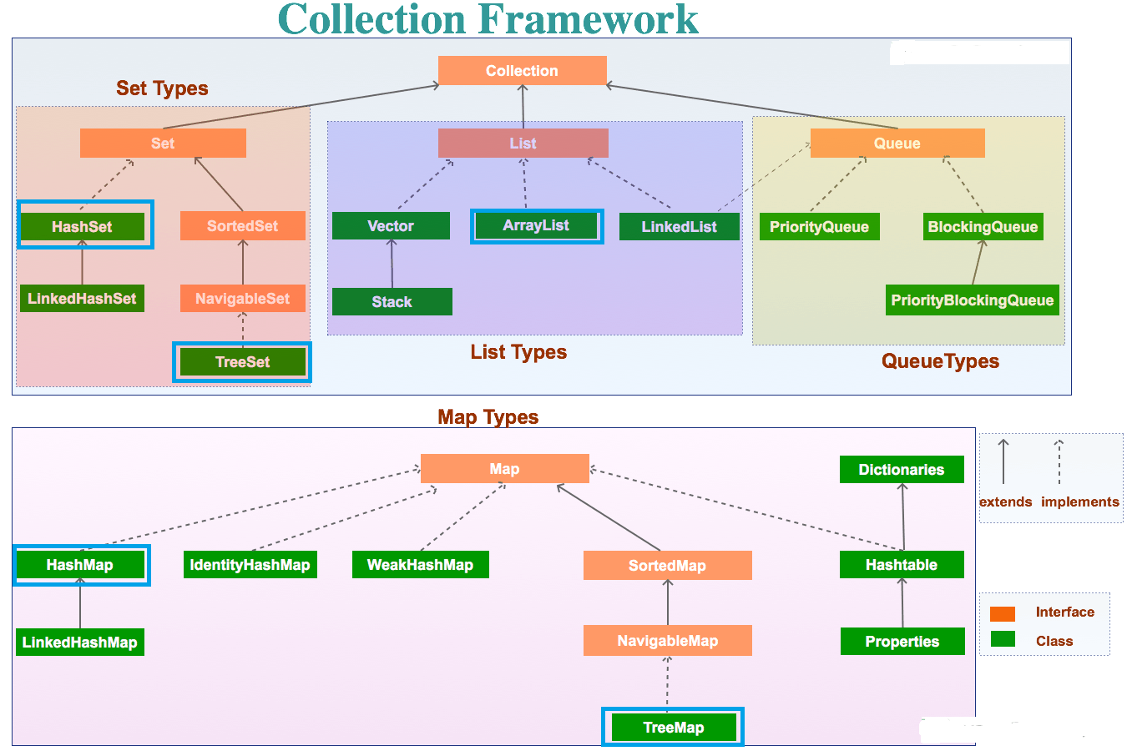
The Collection Hierarchy

Slide 9
Important Methods Of Collections
The Collection interface is one of the root interfaces of the Java collection classes. The general methods list of the collection interface is:
boolean add(Object obj)
void clear( )
boolean contains(Object obj)
boolean equals(Object obj)
int hashCode( )
boolean isEmpty( )
Iterator iterator( )
boolean remove(Object obj)
int size( )

